Slide 1
Mu2e: Search for Muon to Electron Conversion at Fermilab
Eric Prebys Fermilab
For the Mu2e Collaboration

Slide 2
Mu2e Collaboration
~140 collaborators

Slide 3
Outline
Theoretical Motivation
Experimental Technique
Making Mu2e work at Fermilab
Sensitivities
Future Upgrades
Conclusion
Will spend quite a bit of time on this

Slide 4
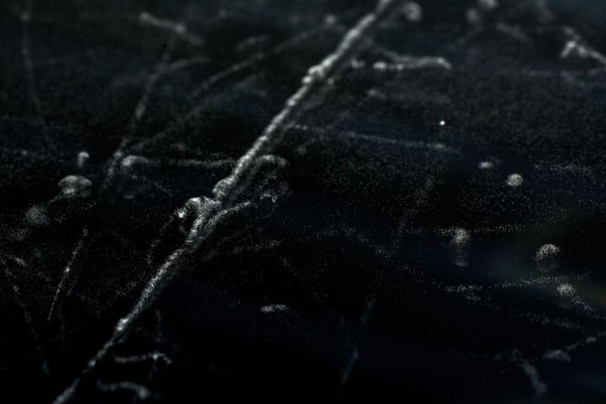
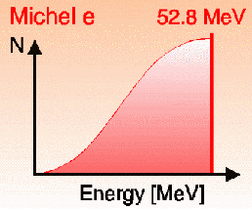
Ancient History
The muon was originally discovered 1936 Anderson and Neddermeyer while studying cosmic ray data
Hypothesized to be Yukawa’s proposed mediator of the nuclear binding force, but did not interact strongly
Yukawa’s particle was the pion
Excited electron?
If so, expect
Not seen!
The muon was observed to decay to electron+”something invisible” with a spectrum consistent with a three body decay
Fast forwarding (and skipping a bunch of stuff)…

Slide 5
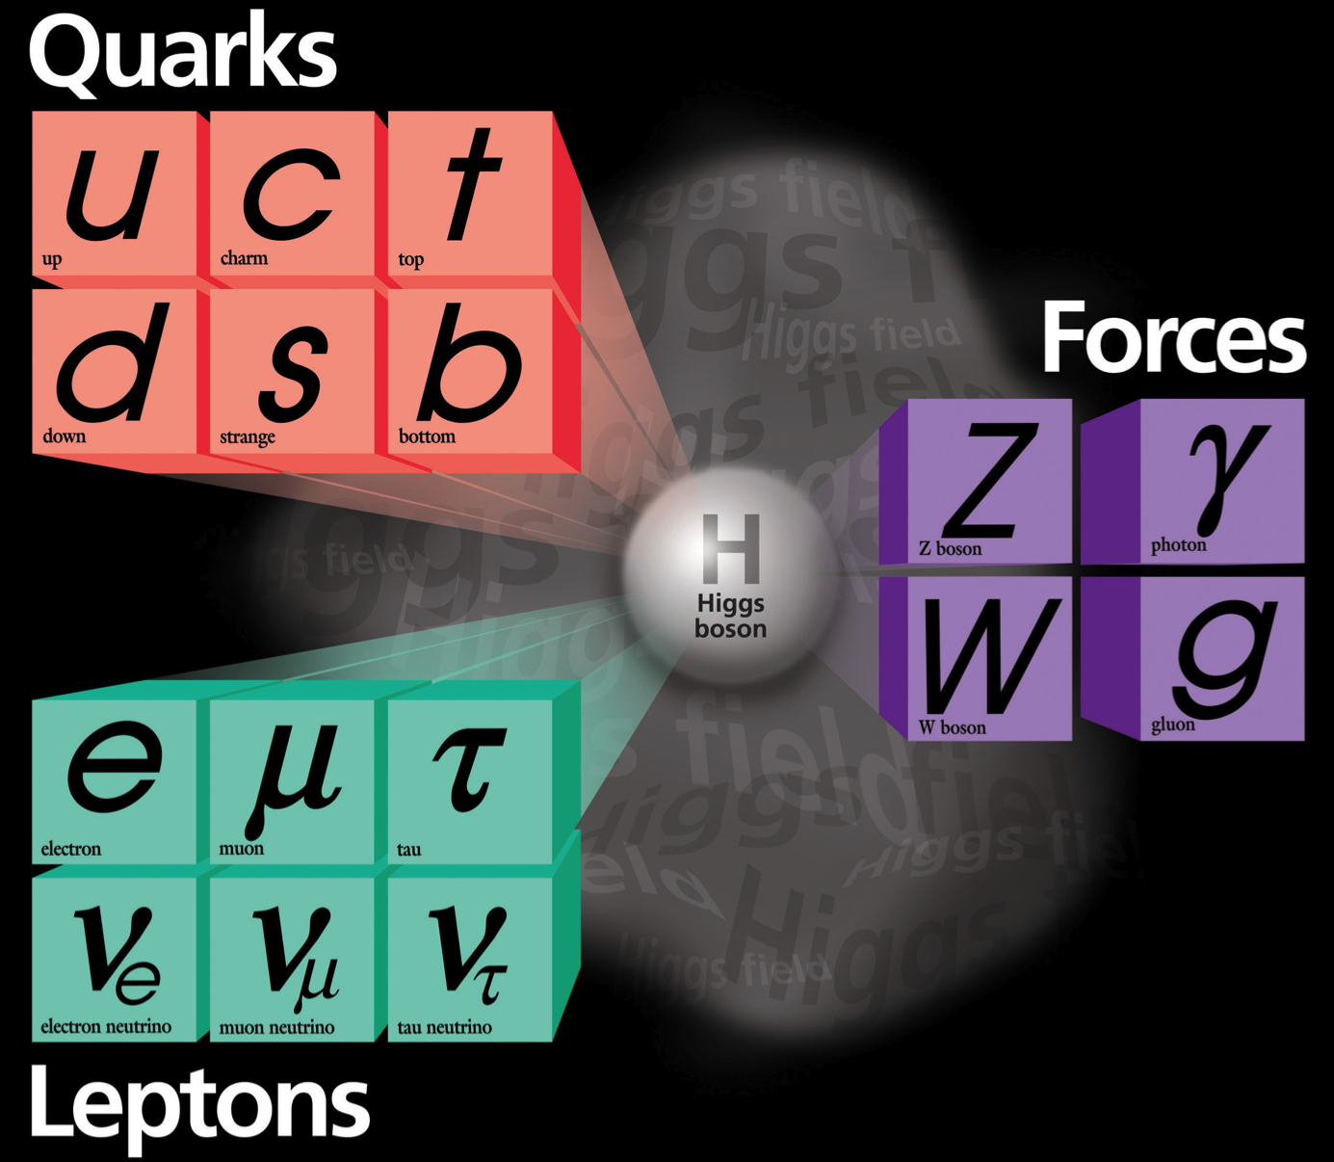
The Standard Model
Fermions
Bosons
Combine to form hadrons
Mediate interactions
Free
Weak charged current interactions “flip” fundamental fermions (analogous to spin flip)
Neutrino mixing

Slide 6
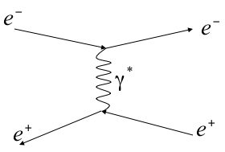
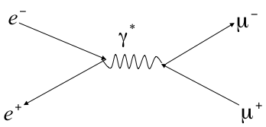
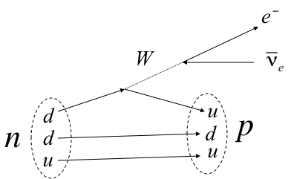
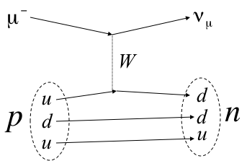
Interactions in the Standard Model

Slide 7
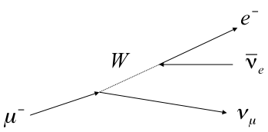
Lepton Number and Lepton Flavor Number
Both lepton number and lepton “flavor” (generation) number are individually conserved*
muon decay
CCQE
*except in neutrino mixing

Slide 8
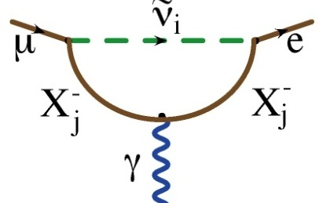
Charged Lepton Flavor Violation
Neutral Current Scattering
Higher order dipole “penguin”:
Virtual ν mixing
OK
Flavor Changing Neutral Current (FCNC):
Observation of neutrino mixing shows this can occur at a very small rate
Photon can be real (μ->eγ) or virtual (μN->eN)
Standard model branching ration ~O(10⁻⁵²) (effectively zero)
Forbidden in Standard Model

Slide 9
Beyond the Standard Model
Because extensions to the Standard Model couple the lepton and quark sectors, Charged Lepton Flavor Violation (CLFV) is a nearly universal feature of such models.
The fact that it has not yet been observed already places strong constraints on these models.
CLFV is a powerful probe of multi-TeV scale dynamics: complementary to direct collider searches
Among various possible CLFV modes, rare muon processes offer the best combination of new physics reach and experimental sensitivity

Slide 10

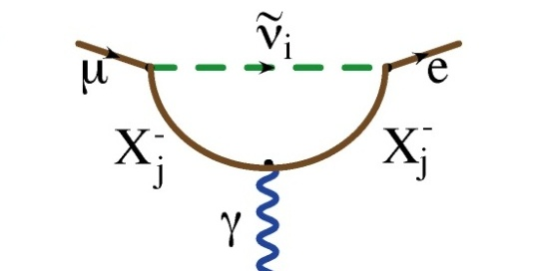
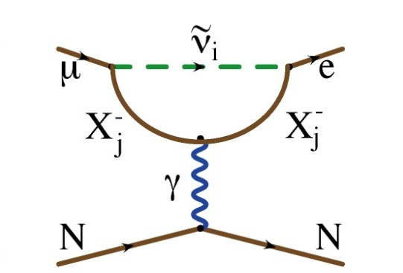
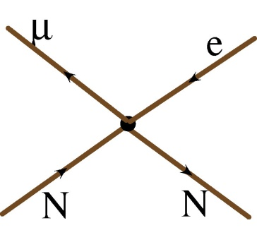
Generic Beyond Standard Model CLFV
Flavor Changing Neutral Current
Dipole (penguin)
Can involve a real photon
Or a virtual photon
?
?
?
Mediated by massive neutral Boson, e.g.
Leptoquark
Z’
Composite
Approximated by “four fermi interaction”
?
?
?

Slide 11
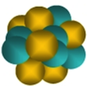
Decay vs. Conversion
Only the “dipole”-like reactions can lead to a decay
However, if we capture a muon on a nucleus, it could exchange either a virtual photon or other (unknown) neutral boson with the nucleus

Slide 12
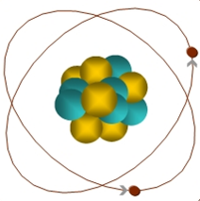
Experimental Signature of μ+N → e+N
When captured by a nucleus, a muon will have an enhanced probability of exchanging a virtual particle with the nucleus.
This reaction recoils against the entire nucleus, producing a mono-energetic electron carrying most of the muon rest energy
μ
~105 MeV e⁻
Similar to μ→eγ, with important advantages:
No combinatorial background.
Because the virtual particle can be a photon or heavy neutral boson, this reaction is sensitive to a broader range of new physics.
Relative rate of μ→eγ and μN→eN is the most important clue regarding the details of the physics

Slide 13
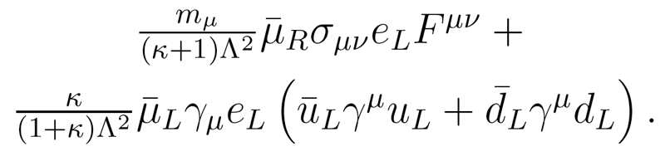
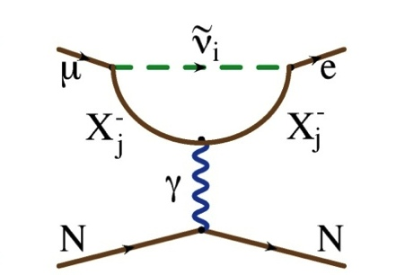
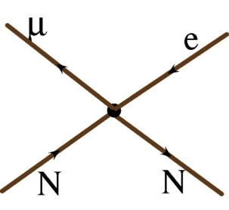
μ→e Conversion vs. μ→eγ
We can parameterize the relative strength of the dipole and four fermi interactions.
Courtesy: A. de Gouvea
?
?
?

Slide 14
Example Sensitivities*
Supersymmetry
Compositeness
Predictions at 10⁻¹⁵
Second Higgs doublet
Heavy Neutrinos
Heavy Z’, Anomalous Z coupling
Leptoquarks
*After W. Marciano

Slide 15
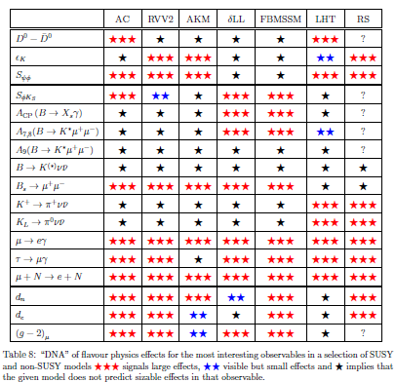
Example: μ→e in SUSY*
SUSY Models
Always a μ→e signal
*from Altmannshofer, Buras, et al, Nucl.Phys.B830:17-94, 2010

Slide 16
History of Lepton Flavor Violation Searches
Best Limits
R_{μe}<7x10⁻¹³ (Sindrum-II 2006)
Br(μ➔eγ) < 2.4x10⁻¹² (MEG 2011)
Br(μ➔3e) < 1x10⁻¹² (Sindrum-I 1988)
Not quite apples-to-apples, but…
Mu2e will measure:
Goal: single even sensitivity of R_{μe}=“a few”x10⁻¹⁷

Slide 17
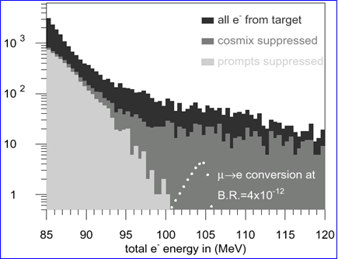
Limits of Previous Experiments
μ−>e Conversion: Sindrum II
Cosmic Background
Most backgrounds are prompt with respect to the beam
Caused either by production or capture or muons
Previous experiments suppressed these backgrounds by vetoing all observed electrons for a period of time after the arrival of each proton.
This leads to a fundamental to a rate limitation.
DIO tail

Slide 18
Mu2e (MELC) Experimental Technique
Eliminate prompt beam backgrounds by using a primary beam consisting of short proton pulses with separation on the order of a muon life time
Design a transport channel to optimize the transport of right-sign, low momentum muons from the production target to the muon capture target.
Design a detector which is very insensitive to electrons from ordinary muon decays
~200 ns
~1.5 μs
Prompt backgrounds
live window

Slide 19
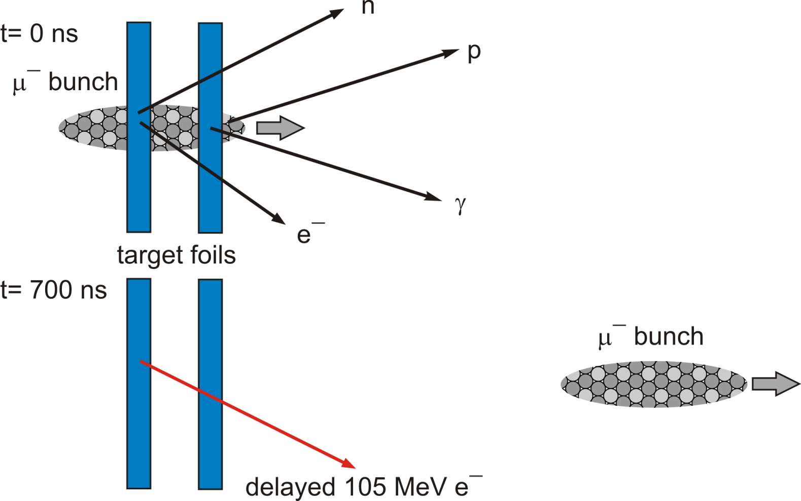
Signal
Muons from bunch are captured on nuclei in target
Wait for prompt backgrounds to subside
Look for muons to decay (or convert!)

Slide 20
Our Biggest Issue: Decay in Orbit (DIO)
In-flight Decay:
Coherent DIO:
N
Very high rate
Peak energy 52 MeV
Must design detector to be very insensitive to these.
Nucleus coherently balances momentum
Rate approaches conversion (endpoint) energy as (E_{conversion}-E)⁵
Drives resolution requirement.

Slide 21
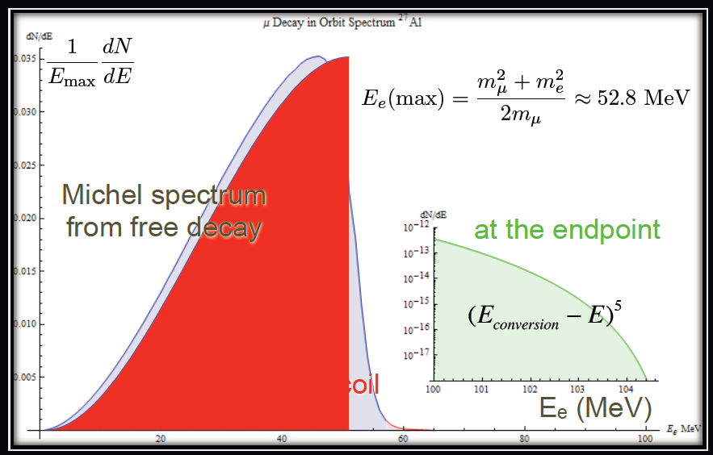
DIO Spectrum

Slide 22
Choosing the Capture Target
Determining the Z dependence is very important, but
Lifetime is shorter for high-Z
Decreases useful live window
Also, need to avoid background from radiative muon capture
⇒Want M(Z)-M(Z-1) < signal energy
⇒Aluminum is nominal choice for Mu2e
Nucleus
R_{μe}(Z) / R_{μe}(Al)
Bound lifetime
Atomic Bind. Energy(1s)
Conversion Electron Energy
Prob decay >700 ns
Al(13,27)
1.0
.88 μs
0.47 MeV
104.97 MeV
0.45
Ti(22,~48)
1.7
.328 μs
1.36 MeV
104.18 MeV
0.16
Au(79,~197)
~0.8-1.5
.0726 μs
10.08 MeV
95.56 MeV
negligible

Slide 23
How do we make muons?
This produces mostly pions
These quickly decay to muons
Hit a target with protons
Muons go much further

Slide 24
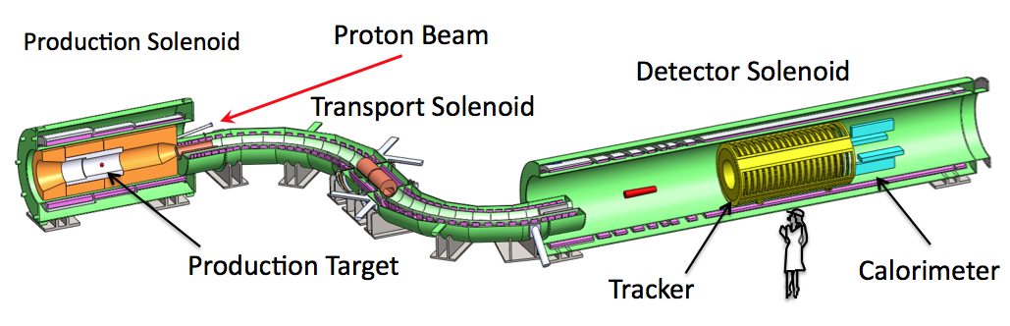
Muon Beam Line and Mu2e Detector
Production Target
Proton beam strikes target, producing mostly pions
Production Solenoid
Contains backwards pions/muons and reflects slow forward pions/muons
Transport Solenoid
Selects low momentum, negative muons
Capture Target, Detector, and Detector Solenoid
Capture muons on Aluminum target and wait for them to decay
Detector blind to ordinary (Michel) decays, with E ≤ ½m_{μ}c²
Optimized for E ~ m_{μ}c²

Slide 25
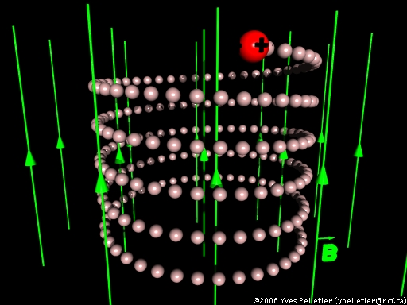
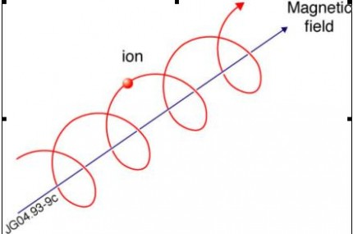
Review: Particle Motion in a Solenoidal Field
Generally, particles move in a helical trajectory
For high momentum particles, the curvature is used to measure the momentum
Low momentum particles are effectively “trapped” along the field lines
A particle trapped along a curved solenoidal field will drift out of the plane of curvature with a velocity
10 MeV/c particle will have a radius of 3 cm in a 1 T field
Can be used to resolve charge and momentum!

Slide 26
Target and Heat Shield
Produces pions which decay into muons
Tungsten Target
8 kW beam
700 W in target
Radiatively cooled
Heat Shield
Bronze insert
3.3 kW average heat load

Slide 27
Production Solenoid
Axially graded ~5 T solenoid captures low energy backward and reflected pions and muons, transporting them toward the stopping target
Magnetic Gradient
Magnetic reflection
(pinch confinement)

Slide 28
Transport Solenoid
Transports muons from production target to capture target
Curved solenoid eliminates line-of-sight backgrounds
Collimator in center selects low momentum negative muons
RxB drift causes sign/momentum dependent vertical displacement

Slide 29
Stopping (capture) Target
Multiple layers to allow decay or conversion electrons to exit with minimal scattering
17 Aluminum foils
200 μm thick
Stops 49% of arriving muons
Conversion electron spectrum:

Slide 30
Detector and Detector Solenoid
Graded field around stopping target to increase acceptance
Magnetic reflection again
Uniform field in tracking volume
Electromagnetic calorimeter to identify electrons.
μ Stopping Target
Muon Absorber
Tracker
EM Calorimeter
Proton Absorber

Slide 31
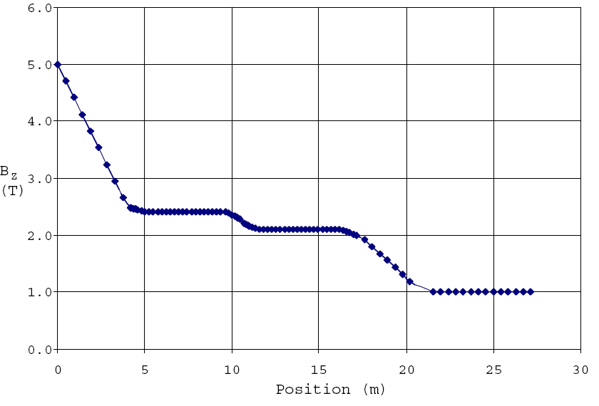
Magnetic Field Gradient
Decreasing field prevents particle trapping and excessive straggling
Production Solenoid
Transport Solenoid
Detector Solenoid

Slide 32
Particle Detector
Helical trajectory
Conversions hit multiple planes.
Electromagnetic Calorimeter to tag electrons
Most decays (p_{T}<53 MeV/c) go down the middle (vacuum)

Slide 33
Particle Tracking Technology
To achieve the required resolution, must keep mass as low as possible to minimize scattering
We’ve chosen transverse planes of “straw chambers” (21,600 straws)
Advantages
Established technology
Modular: support, gas, and electronic connections at the ends, outside of tracking volume
Broken wires isolated
Challenges
Our specified wall thickness (15 μm) has never been done
Operating in a vacuum may be problematic
Track ionizes gas in tube
Charge drifts to sense wire at center
Drift time gives precision position

Slide 34
A long time coming
1992 | Proposed as “MELC” at Moscow Meson Factory
1997 | Proposed as “MECO” at Brookhaven (at this time, experiment incompatible with Fermilab)
1998-2005 | Intensive work on MECO technical design
July 2005 | Entire rare-decay program canceled at Brookhaven
2006 | MECO subgroup + Fermilab physicists work out means to mount experiment at Fermilab
October 2007 | Mu2e letter of intent submitted to Fermilab
Fall 2008 | Mu2e Proposal submitted to Fermilab
November 2008 | Stage 1 approval. Formal Project Planning begins
November 2009 | DOE Grants CD-0
In DOE project-speak, this is the first “Critical Decision”: Statement of mission need = official existence

Slide 35
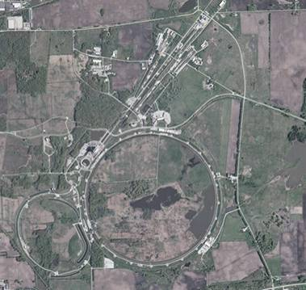
Context (evolving slide)
Fermilab
Built ~1970
200 GeV proton beams
Eventually 400 GeV
Upgraded in 1985
900GeV x 900 GeV p-pBar collisions
Most energetic in the world ever since
Upgraded in 1997
Main Injector-> more intensity
980 GeV x 980 GeV p-pBar collisions
Intense neutrino program
Soon the second most powerful collider
What next???
With the LHC now the highest energy collider, Fermilab must focus on different types of physics.
until recently
For awhile

Slide 36
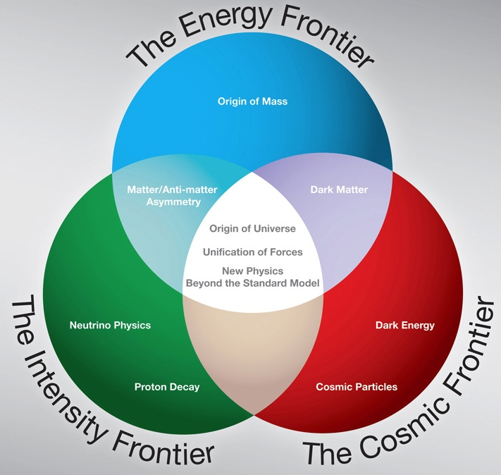
New Directions
To address the changing situation, the DOE’s High Energy Physics Advisory Panel (HEPAP) convened the Particle Physics Prioritization Panel (P5)
In 2008, this panel released a report outlining a strategic plan for US particle physics focused on three “frontiers”
Now that the LHC has taken over the energy frontier, Fermilab’s focus is shifting
LHC
Tevatron
Mu2e

Slide 37
The Intensity Frontier at Fermilab
Neutrino Physics
Increasing the power of 120 GeV beam from Fermilab’s Main Injector to 700 kW for
NOvA – neutrino beam to an off-axis detector near Canadian border
“Long Baseline Neutrino Experiment” (LBNE) – eventually an intense beam pointed at the Deep Underground Science and Engineering Laboratory, to be built at the Homestake Mine, SD
Precision measurements
Muon to electron conversion
Anomalous muon magnetic moment (g-2).
Precision kaon physics
Advanced R&D
Muon based neutrino factory
Muon collider
Accelerator-driven sub-critical nuclear reactors
Us

Slide 38
Our Role in the Big Picture
As part of their charge, the P5 evaluated specific proposals under various funding scenarios. With regard to Mu2e, they recommended:
“The experiment could go forward in the next decade with a modest evolution of the Fermilab accelerator complex. Such an experiment could be the first step in a world-leading muon-decay program eventually driven by a next-generation highintensity proton source. The panel recommends pursuing the muon-to-electron conversion experiment... under all budget scenarios considered by the panel”
Mu2e will play a central role in the US HEP program
Now on with the show…

Slide 39
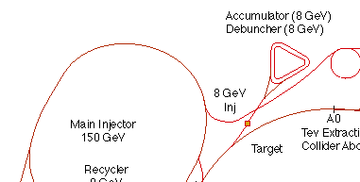
The Fermilab Accelerator Complex
We will use all of this
MiniBooNE/BNB
NUMI

Slide 40
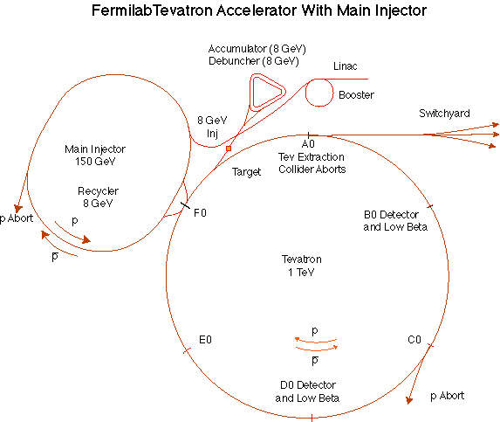
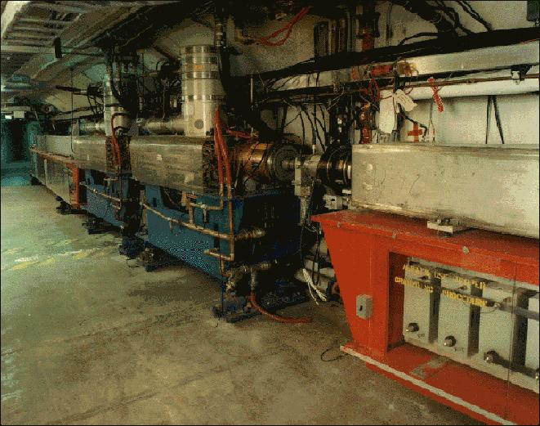
Booster
Accelerates the 400 MeV beam from the Linac to 8 GeV
Operates in a 15 Hz offset resonant circuit
Cannot make required beam structure
That’s why MECO wasn’t proposed there
Sets fundamental clock of accelerator complex
More or less original equipment
40+ years old
Supplying beam to neutrino program and Mu2e will require ~doubling output
Hardware limits ➔ Improve RF system
Radiation limits ➔ Improve acceleration efficiency
➔ “Proton Improvement Plan” (whole separate talk)

Slide 41
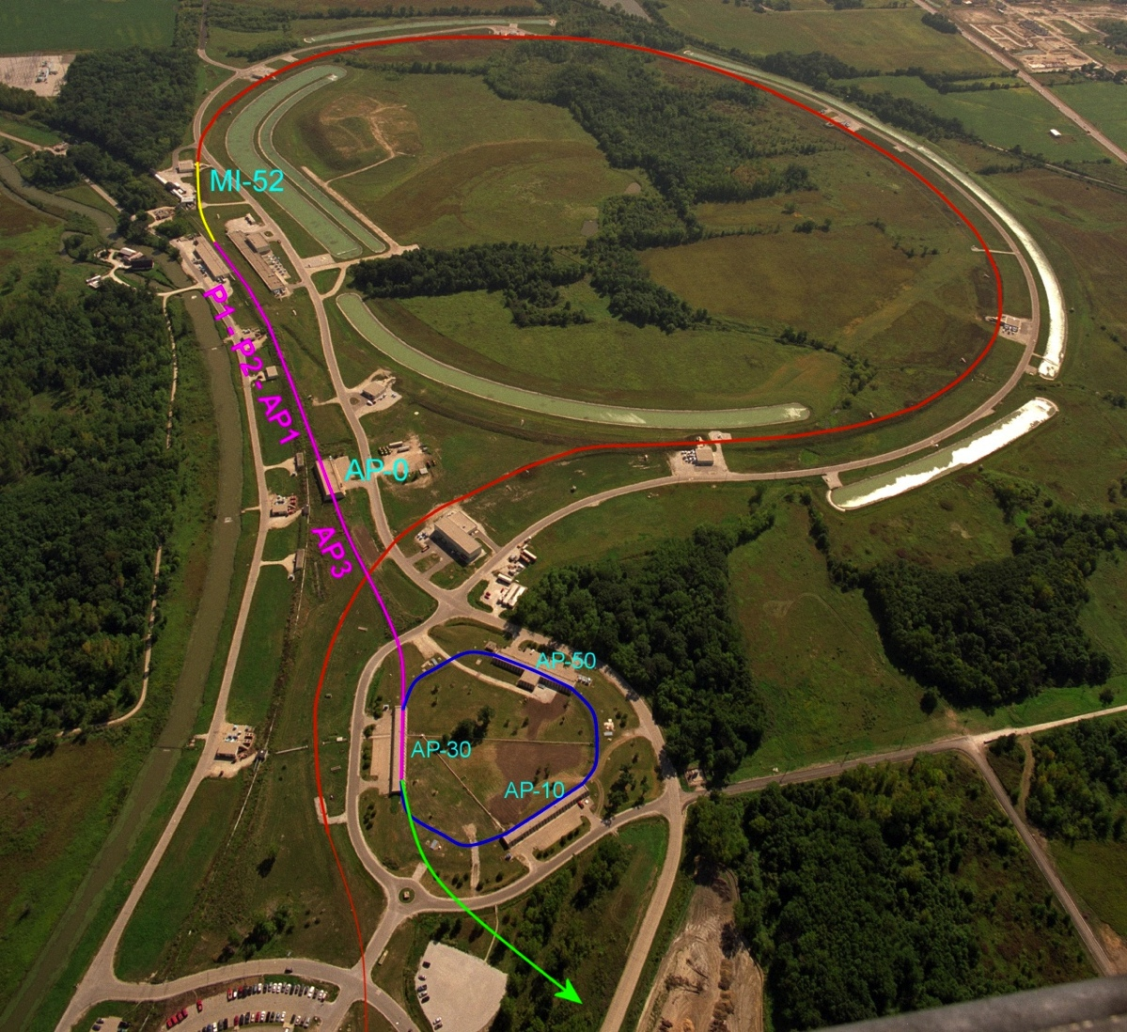
Mu2e Proton Delivery
One Booster “batch” is injected into the Recycler (8 GeV storage ring).
4x10¹² protons
1.7 μsec long
It is divided into 4 bunches of 10¹² each
These are extracted one at a time to the Delivery Ring
Period = 1.7 μsec
As a bunch circulates, it is resonantly extracted to produce the desired beam structure.
Bunches of ~3x10⁷ protons each
Separated by 1.7 μsec
Main Injector/Recycler
Delivery Ring (formerly pBar Debuncher)
Mu2e
Booster

Slide 42
Resonant Extraction
Extracting all the beam at once is easy, but we want to extract it slowly over ~60 ms (~35,000 revolutions)
Use nonlinear (sextupole) magnets to drive a harmonic instability
Extract unstable beam as it propagates outward
Standard technique in accelerator physics
Unstable beam motion in N(order) turns
Extraction Field
Extracted beam
Lost beam
Septum

Slide 43
Mu2e Spill Structure
1.33 sec Main Injector cycle
Detail:
3x10⁷ p/bunch
1.7 μsec bunch spacing
~30% duty factor
~1.2x10²⁰ protons year

Slide 44
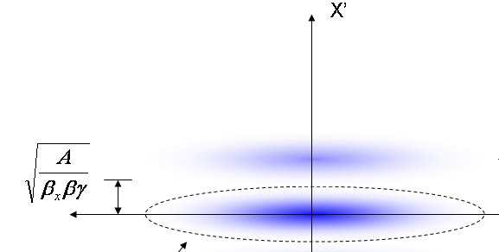
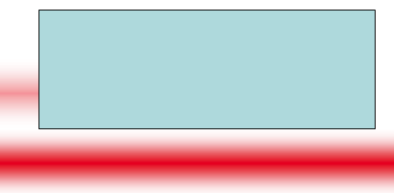
Beam line extinction
A set of resonant dipoles in the beam deflects beam such that only in-time beam is transmitted through a system or collimators:
Think miniature golf!
Use resonant dipoles at two frequencies
½ bunch frequency to sweep out of time beam into collimators
High harmonic to reduce motion during transmission window
At dipole:
At collimator:
Out of time
In time

Slide 45
Extinction Monitor
Must measure extinction to 10⁻¹⁰ precision
Roughly 1 proton every 300 bunches!
Monitor sensitive to single particles not feasible
Would have to be blind to the 3x10⁷ particles in the bunch.
Focus on statistical technique
Design a monitor to detect a small fraction of scattered particles from target
10-50 per in-time bunch
Good timing resolution
Statistically build up precision profile for in time and out of time beam.
Goal
Measure extinction to 10⁻¹⁰ precision in one hour.

Slide 46
Extinction Monitor Design
Selection channel built into target dump channel
Spectrometer based on ATLAS pixels
Optimized for few GeV/c particles

Slide 47
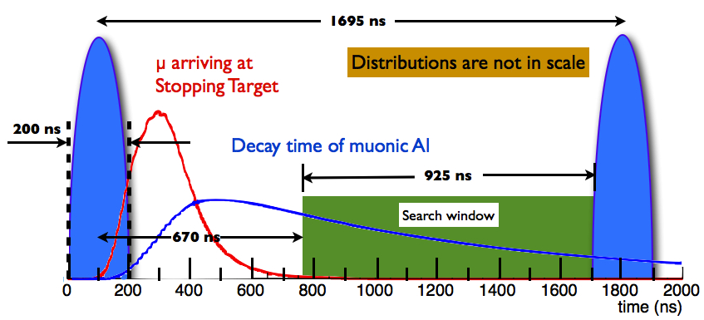
End Product
μ⁻ are accompanied by e⁻, π⁻, …
Extinction system makes prompt background ~equal to all other backgrounds
1 out of time proton per 10¹⁰ in time protons.
Lifetime of muonic Al: 864 ns.

Slide 48
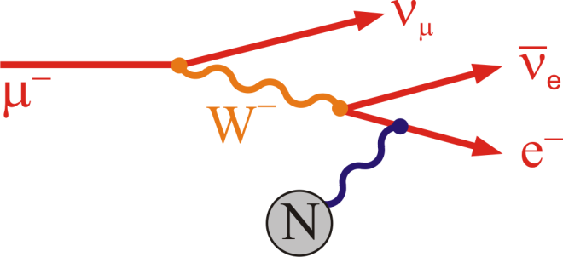
Major Backgrounds
1. Muon decay in orbit (DIO)
μ⁻ → e⁻νν
E_{e} < m_{μ}c² – E_{NR} – E_{B}
N ∼ (E_{conversion} - E_{e})⁵
Fraction within 3 MeV of endpoint ∼ 5x10⁻¹⁵
Defeated by good energy resolution

Slide 49
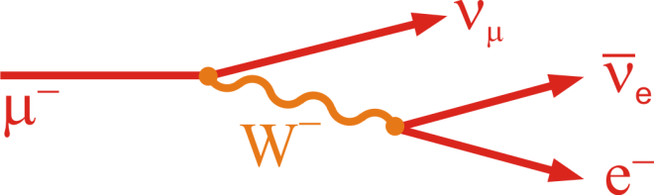
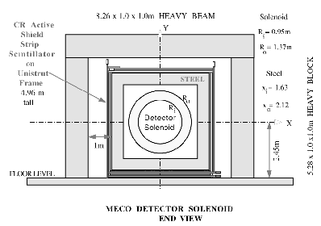
Backgrounds (cont’d)
2. Beam Related Backgrounds
Goal: Prompt background ~equal to all other backgrounds
Radiative π⁻ capture:
π⁻N →N*γ, γZ → e⁺e⁻
Muon decay in flight:
μ⁻ → e⁻νν
Since E_{e} < m_{μ}c²/2, p_{μ} > 77 GeV/c
Beam electrons
Pion decay in flight:
π⁻ → e⁻ν_{e}
Suppressed by minimizing beam between bunches and waiting
Need ≲ 10⁻¹⁰ extinction (see previous discussion)
3. Asynchronous Backgrounds
Cosmic rays
suppressed by active and passive shielding

Slide 50
Pattern Recognition
All hits from 500-1694 ns
Hits within ±50 ns conversion electron

Slide 51
Sensitivity
Cuts chosen to maximize signficance
3.6x10²⁰ protons on target
3 years nominal running
Single Event Sensitivity: R_{μe}=2x10⁻¹⁷

Slide 52
Significance
Backgrounds
Bottom line:
Single event sensitivity: R_{μe}=2x10⁻¹⁷
90% C.L. (if no signal) : R_{μe}<6x10⁻¹⁷
Typical SUSY Signal: ~50 events or more
4 order of magnitude improvement!

Slide 53
Mu2e Schedule

Slide 54
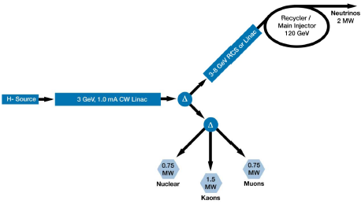
Looking toward the future: Project X
Maximizing the intensity of the Main Injector will require replacing Fermilab’s aging proton source.
In 2007 the Fermilab Long Range Steering committee endorsed a design based on a linac incorporating ILC RF technology
Temporarily named “Project X”
Specification has undergone many iterations. Current incarnation
Muon program driven by 3 GeV CW linac beam

Slide 55
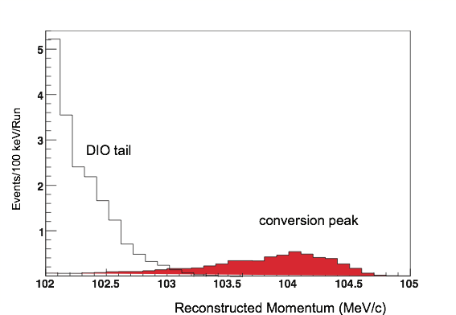
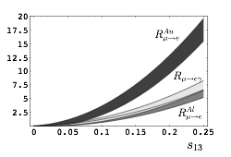
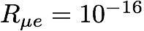
Upgrade scenarios
Mu2e Signal?
No
Yes
Both prompt and DIO backgrounds must be lowered to measure
Must upgrade all aspects of production, transport and detection.
Must compare different targets.
Optimize muon transport and detector for short bound muon lifetimes.
Backgrounds might not be as important.
Rμe ~ 10⁻¹⁸

Slide 56
Target Dependence
Now we know this!

Slide 57
Experimental Challenges for Increased Flux
At our level of sensitivity, we hit fundamental limits with this technique
Simply increasing the proton flux will not improve the limit dramatically
Improve momentum resolution for the ~100 MeV electrons to reject high energy tails from ordinary DIO electrons.
Limited by multiple scattering in target and detector plane
➔ go to bunched, mono-energetic muon beam, allowing for thinner target
Allow longer decay time for pions to decay
Both of these lead to a decay/compressor ring
Other issues with increased flux
Upgrade target and capture solenoid to handle higher proton rate
Target heating
Quenching or radiation damage to production solenoid
High rate detector
All of these efforts will benefit immensely from the knowledge and experience gained during the initial phase of the experiment.
If we see a signal a lower flux, can use increased flux to study in detail
Precise measurement of R_{μe}
Target dependence
Comparison with μ→eγ rate

Slide 58
Conclusions
We have proposed a realistic experiment to measure
Initial single event sensitivity of R_{μe}=2x10⁻¹⁷
This represents an improvement of four orders of magnitude compared to the existing limit, or over a factor of ten in effective mass reach. For comparison
TeV -> LHC = factor of 7
LEP 200 -> ILC = factor of 2.5
ANY signal would be unambiguous proof of physics beyond the Standard Model
The absence of a signal would be a very important constraint on proposed new models.

Slide 59
Backup Slides

Slide 60
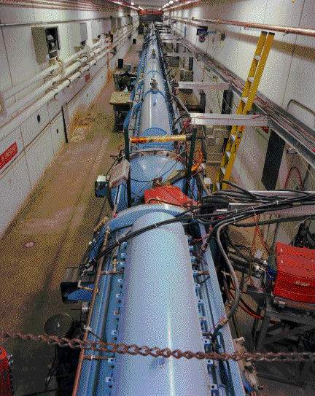
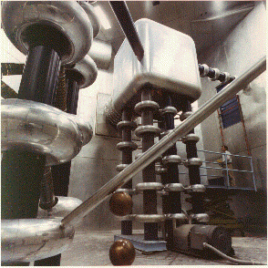
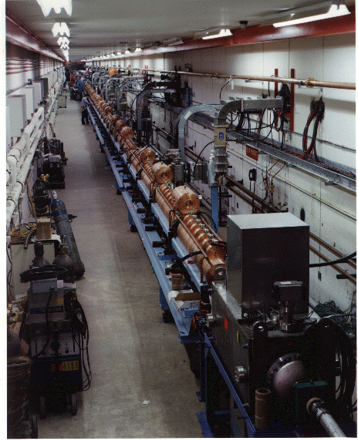
Preac(cellerator) and Linac
“New linac” (HEL)- Accelerate H- ions from 116 MeV to 400 MeV
“Preac” - Static Cockroft-Walton generator accelerates H- ions from 0 to 750 KeV.
“Old linac”(LEL)- accelerate H- ions from 750 keV to 116 MeV

Slide 61
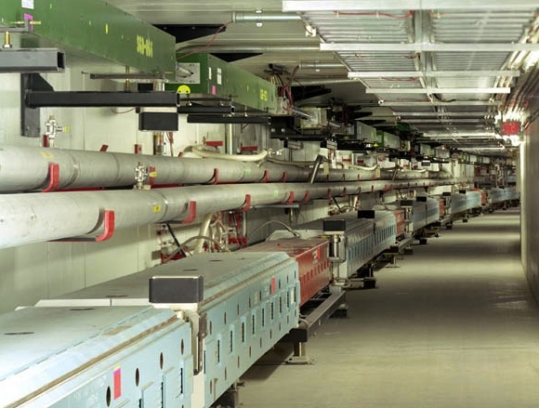
Main Injector/Recycler
The Main Injector can accept 8 GeV protons OR antiprotons from
Booster
The anti-proton accumulator
The 8 GeV Recycler (which shares the same tunnel and stores antiprotons)
It can accelerate protons to 120 GeV (in a minimum of 1.4 s) and deliver them to
The antiproton production target.
The fixed target area.
The NUMI beamline.
It can accelerate protons OR antiprotons to 150 GeV and inject them into the Tevatron.

Slide 62
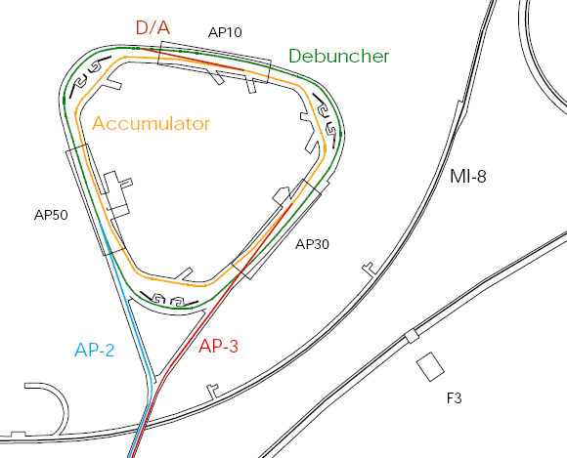
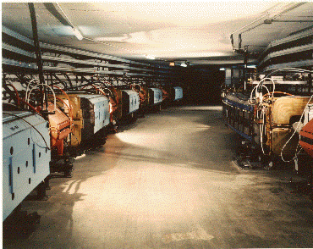
Present Operation of Debuncher/Accumulator
Protons are accelerated to 120 GeV in Main Injector and extracted to pBar target
pBars are collected and phase rotated in the “Debuncher”
Transferred to the “Accumulator”, where they are cooled and stacked
pBars not used after collider.

Slide 63
Mu2e in the NOvA era
Beam Delivered in 15 Hz “batches” from the Fermilab Booster

Slide 64
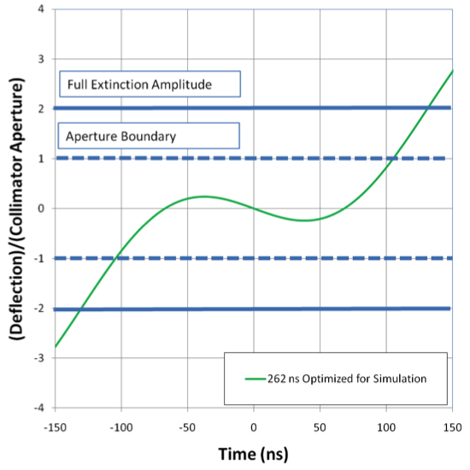
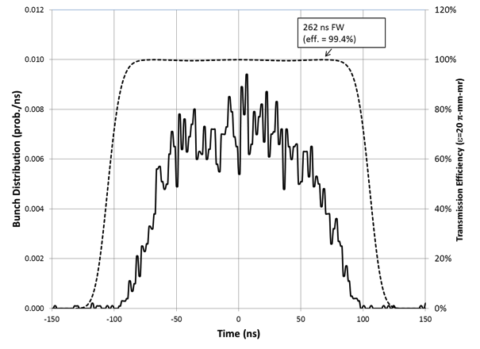
Extinction Performance
Beam motion in Collimator
Bunch
Transmission Window
Additional 10⁻⁵ extinction from beam delivery system

